Slide 1
INTRODUCTIONS
1. Name
2. In what city were you born?
3. What you consider your “hometown”?
4. Program and Degree?
5. Thesis topic…in emojis
6. Hobbies or what you do to relax.
DISCUSS
1. Motivation for taking the class
2. Concerns about this class (in particular) and this semester (in general)?
3. Big Question on the next slide
4. Record all this on the slides to report back to the group

Slide 2
What
are
“DATA”

Slide 3
INTRODUCTIONS
1. Name
2. In what city were you born?
3. What you consider your “hometown”?
4. Program and Degree?
5. Thesis topic…in emojis
6. Hobbies or what you do to relax.
DISCUSS
1. Motivation for taking the class
2. Concerns about this class (in particular) and this semester (in general)?
3. Big Question on the next slide
4. Record all this on the slides to report back to the group

Slide 4
What
are
“DATA”

Slide 5
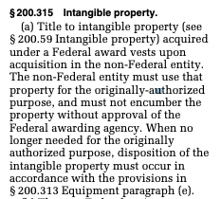
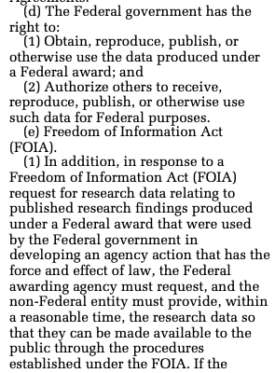
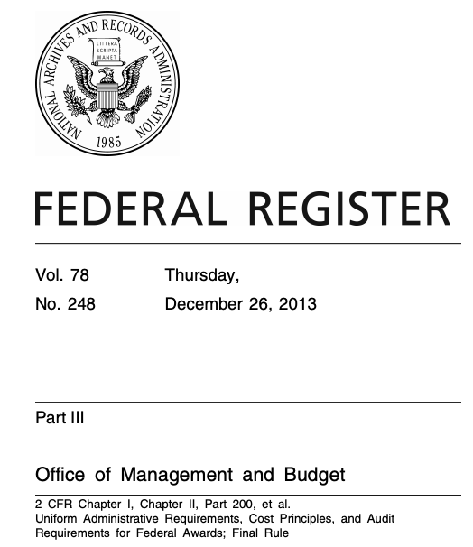
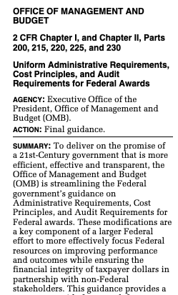
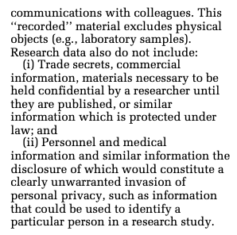
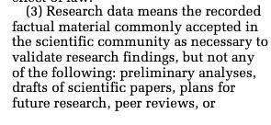
Uniform Administrative Requirements, Cost Principles, and Audit Requirements for Federal Awards § 200.315(3)(e)(3)

Slide 8
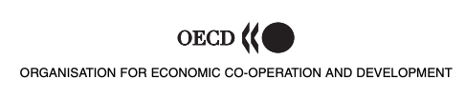

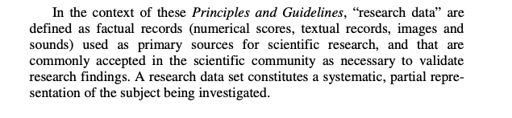
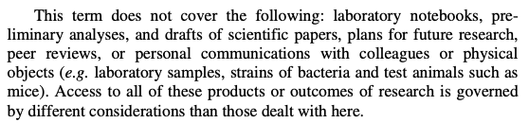

Slide 9
Anything you perform analysis upon.
Kristin Briney, p. 6

Slide 10
With that in mind….
Identify different kinds of data collected in different disciplines
How are these data collected / recorded?
But first….

Slide 11
WHAT IS
MY
MOTIVATION?
short answer: data management might be the most important skill you learn at UF

Slide 12
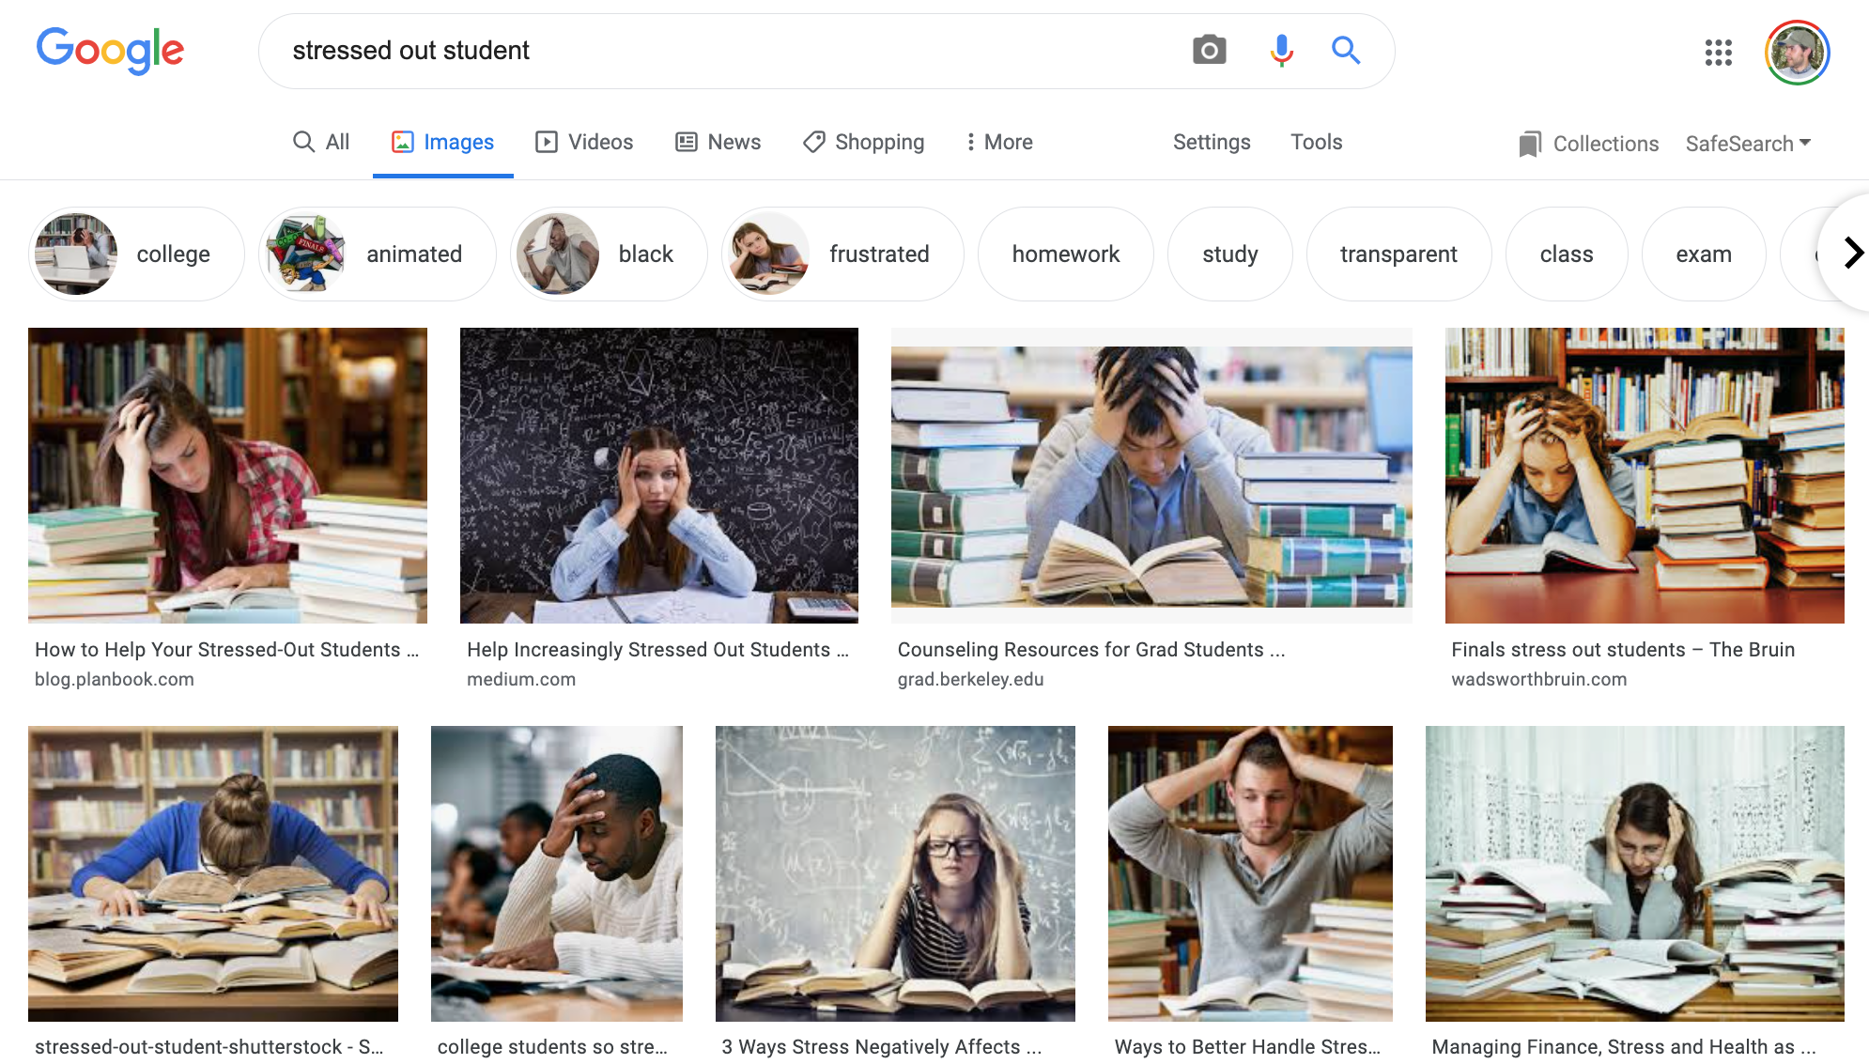
Longer answer:
Reason 1

Slide 13
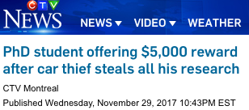
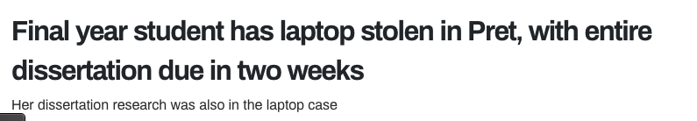


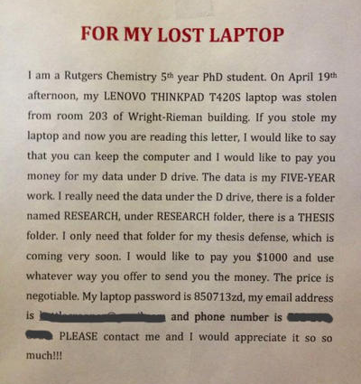
“The thief stole a backpack containing his laptop, a notebook, and a thumb drive with all his backup material... With all his work gone, he will likely have to head back to the lab and redo experiments, delaying graduation by months.”
https://tinyurl.com/yxbwo7qw
https://tinyurl.com/y5amkf6m
https://tinyurl.com/yyosxmeb

Slide 14
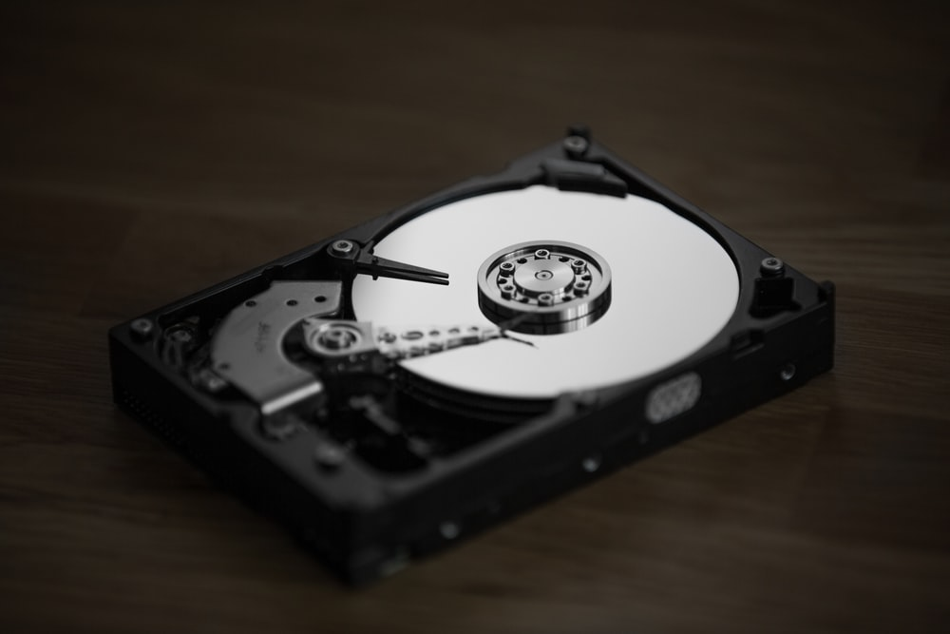
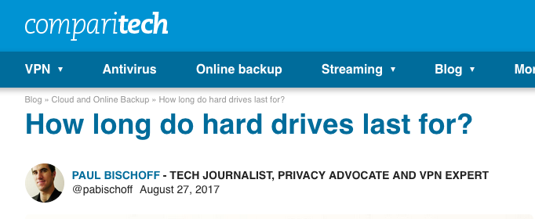

Slide 15
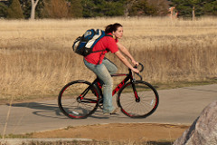
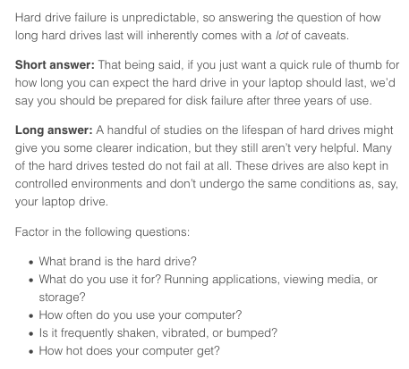
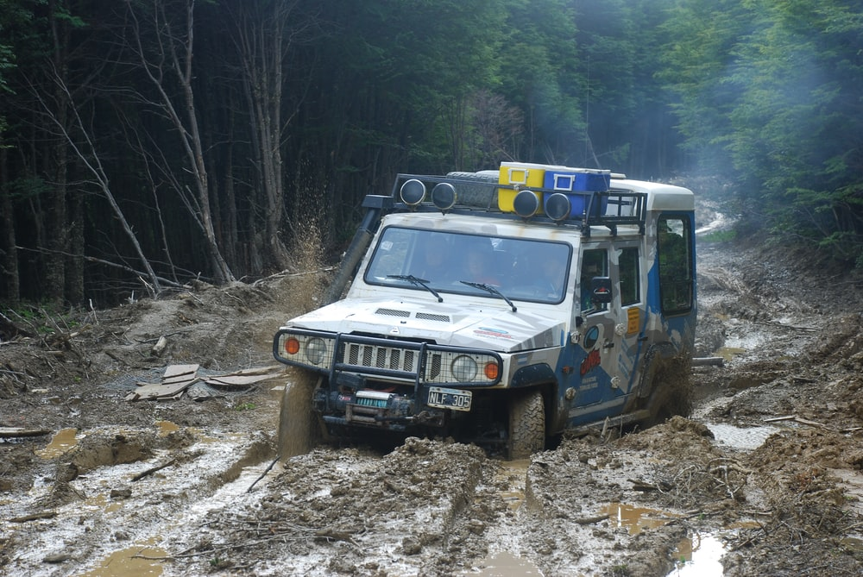
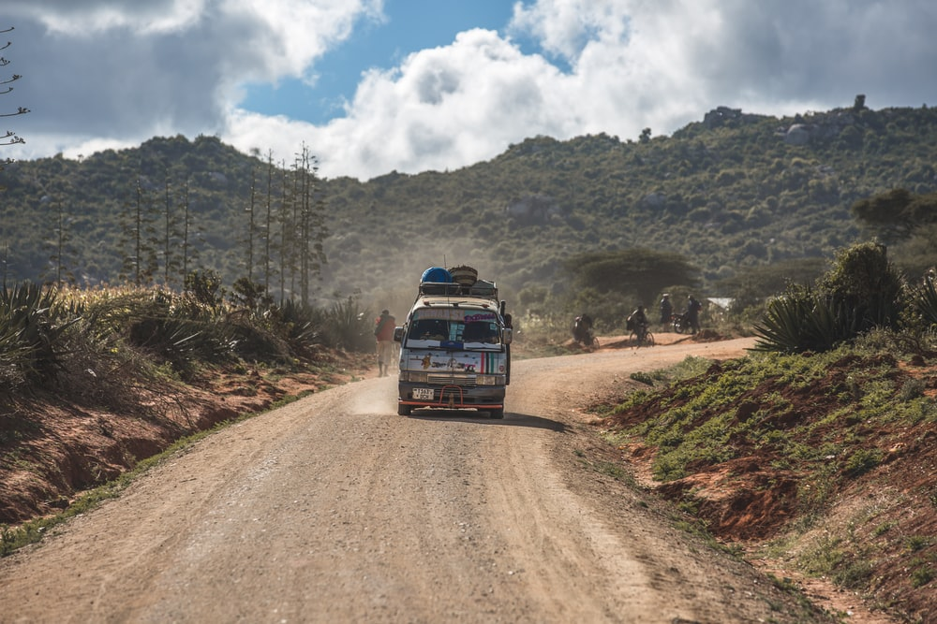

What causes hard drive failure?
Answer: Factory defects & vibration
(for the most part)
Photo: Zane Selvans (CC BY-NC-SA 2.0)

Slide 16
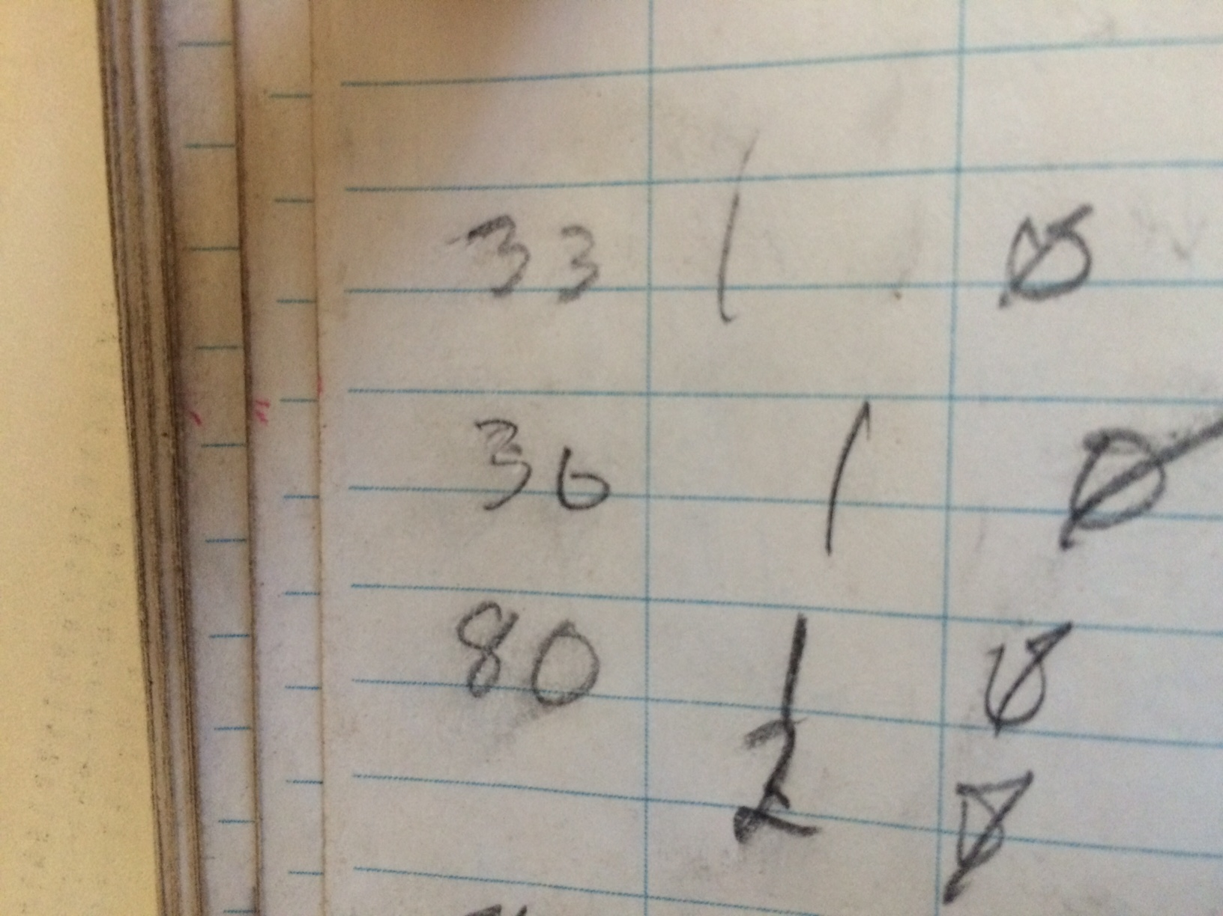
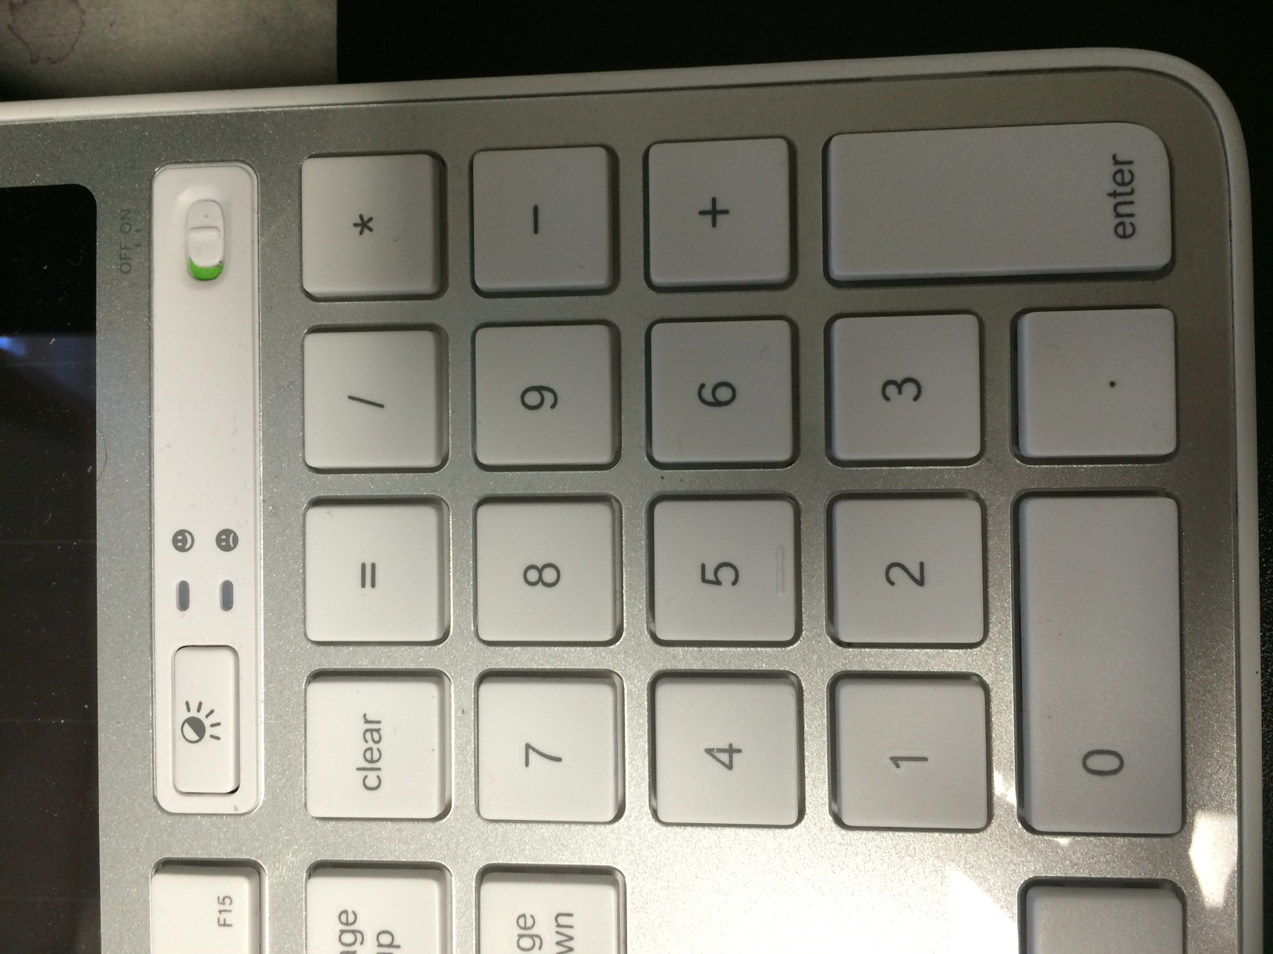
Uhhh....
The 6/3 Problem

Slide 17

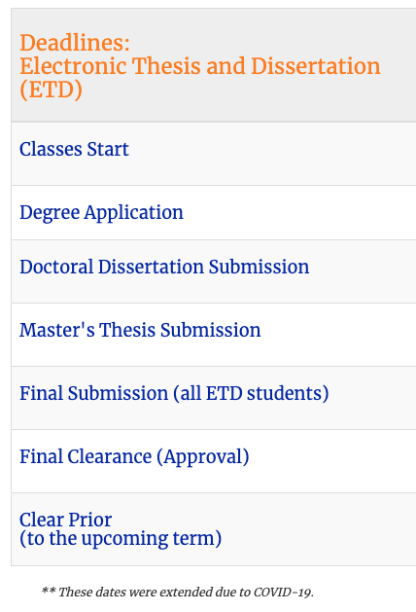
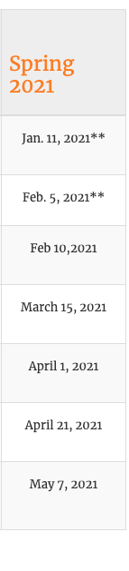
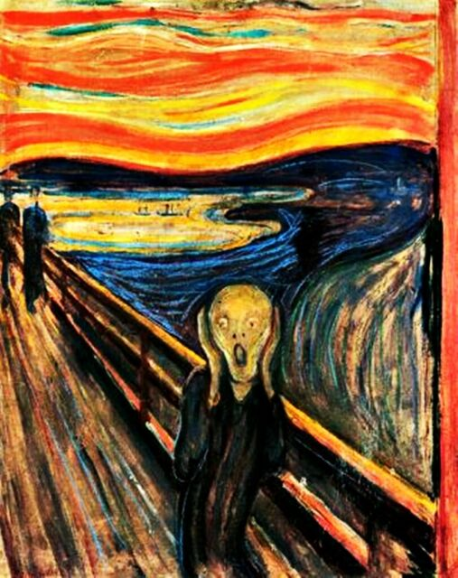

Slide 18
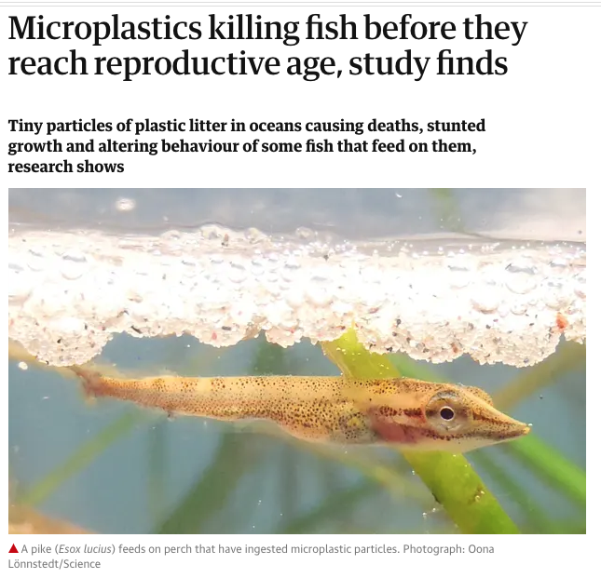

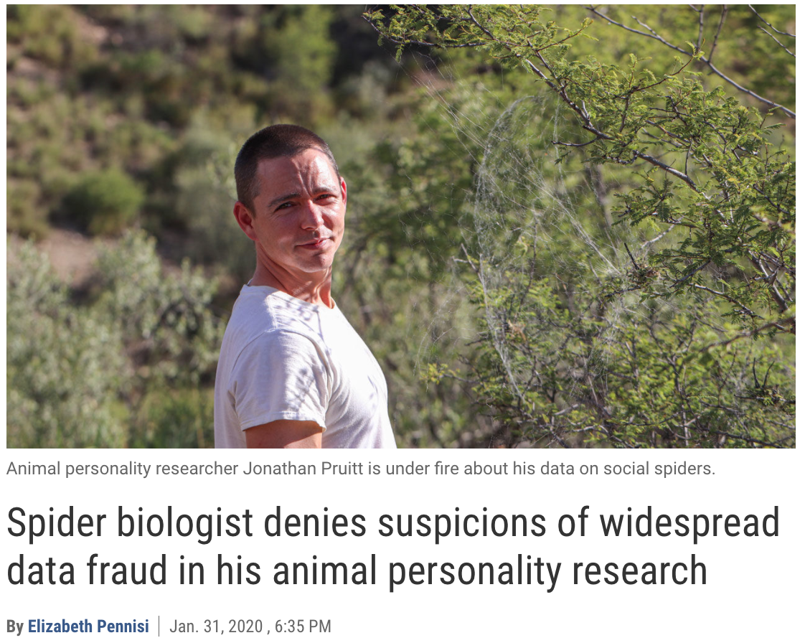
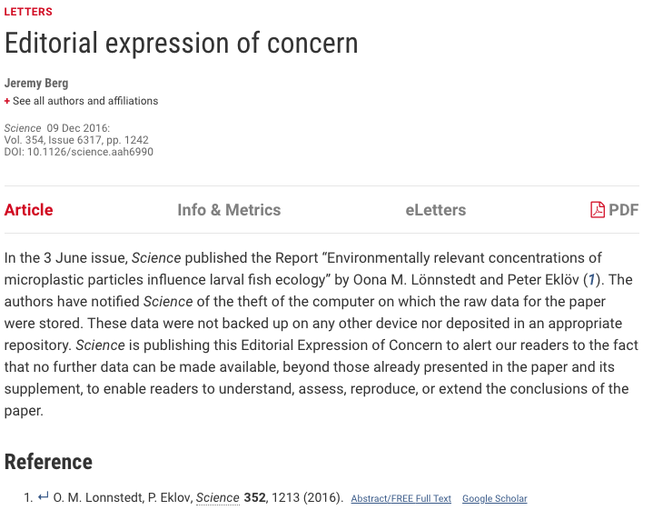

Longer answer:
Reason 2
doi:10.1126/science.abb1258

Slide 19
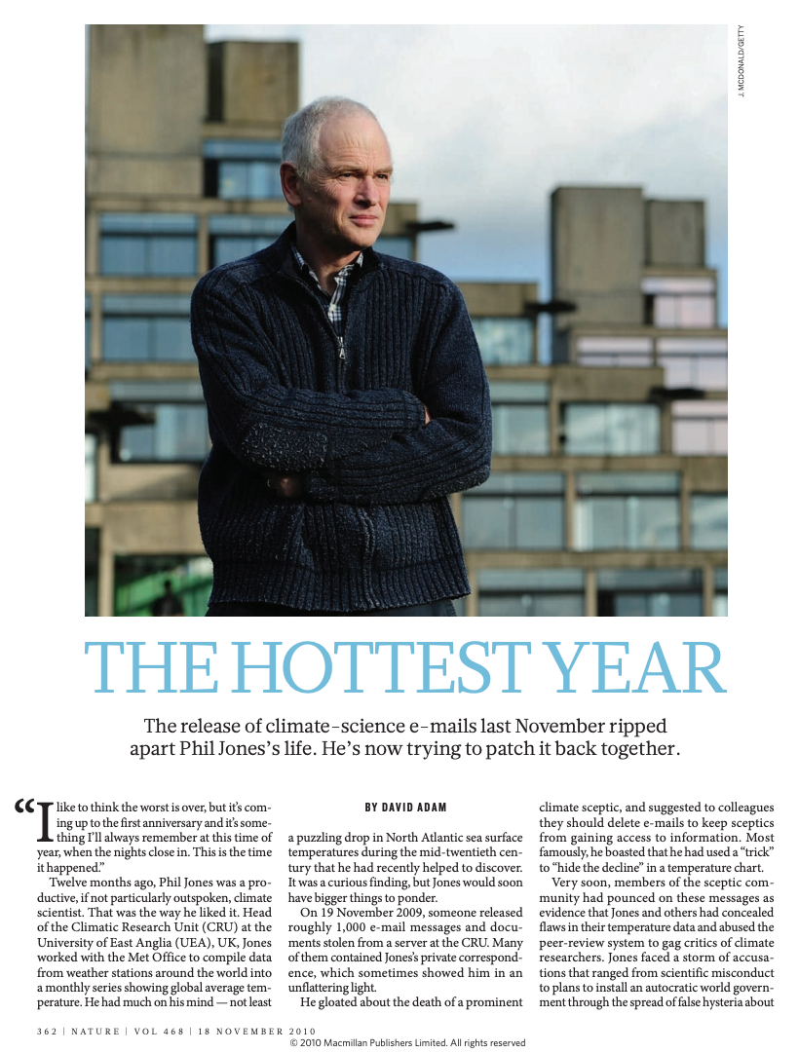
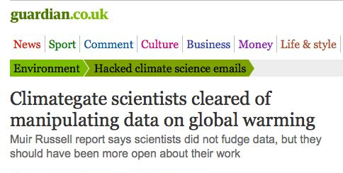

Slide 20

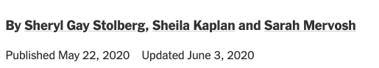
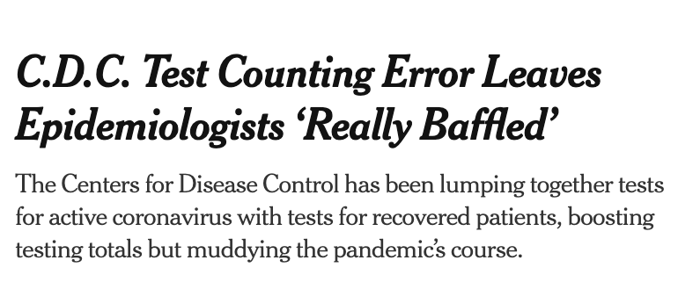
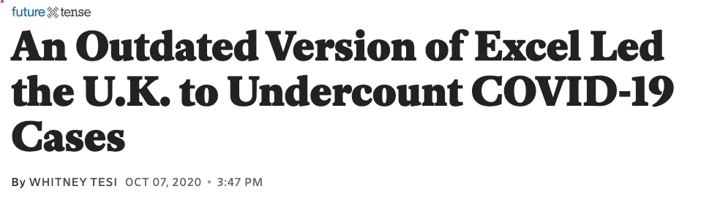


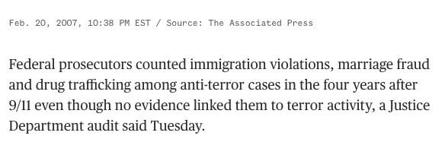
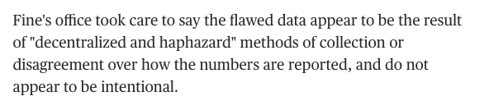
Longer answer:
Reason 3

Slide 21

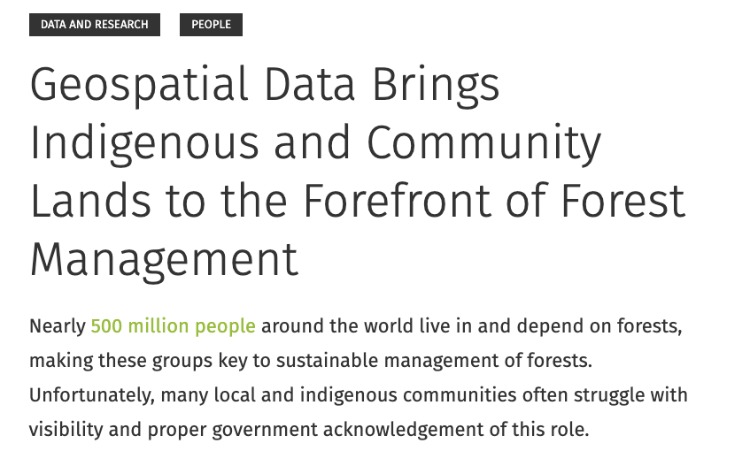
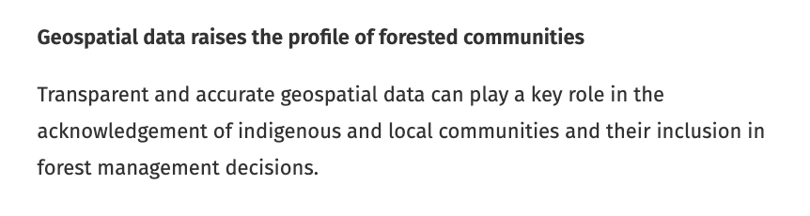



Slide 22

Longer answer:
Reason 4

Slide 23


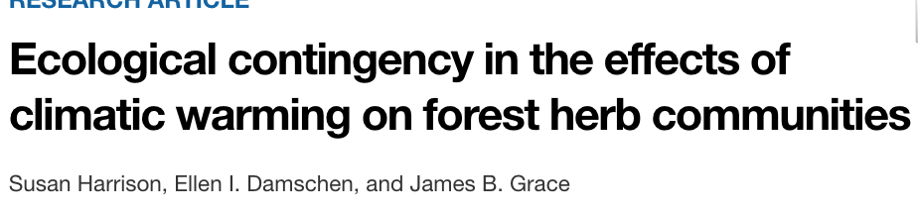
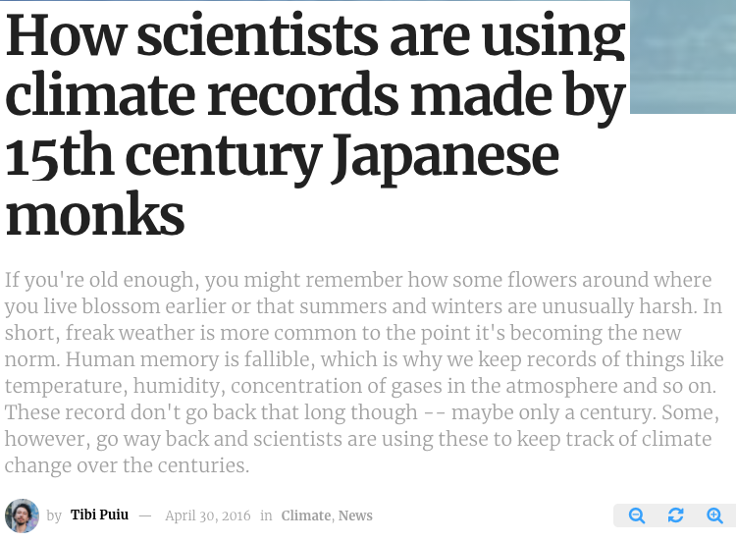
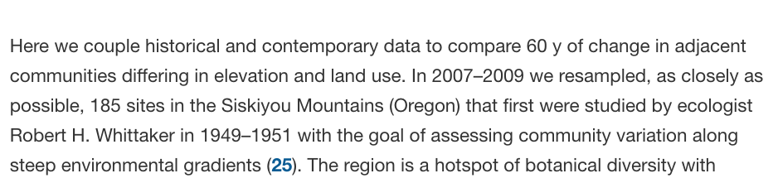
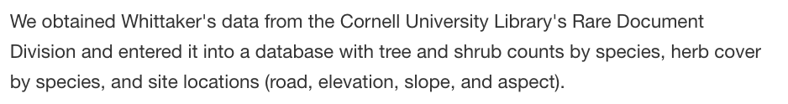
https://www.zmescience.com/ecology/climate/climate-change-japanese-monks/
https://www.pnas.org/content/107/45/19362

Slide 24
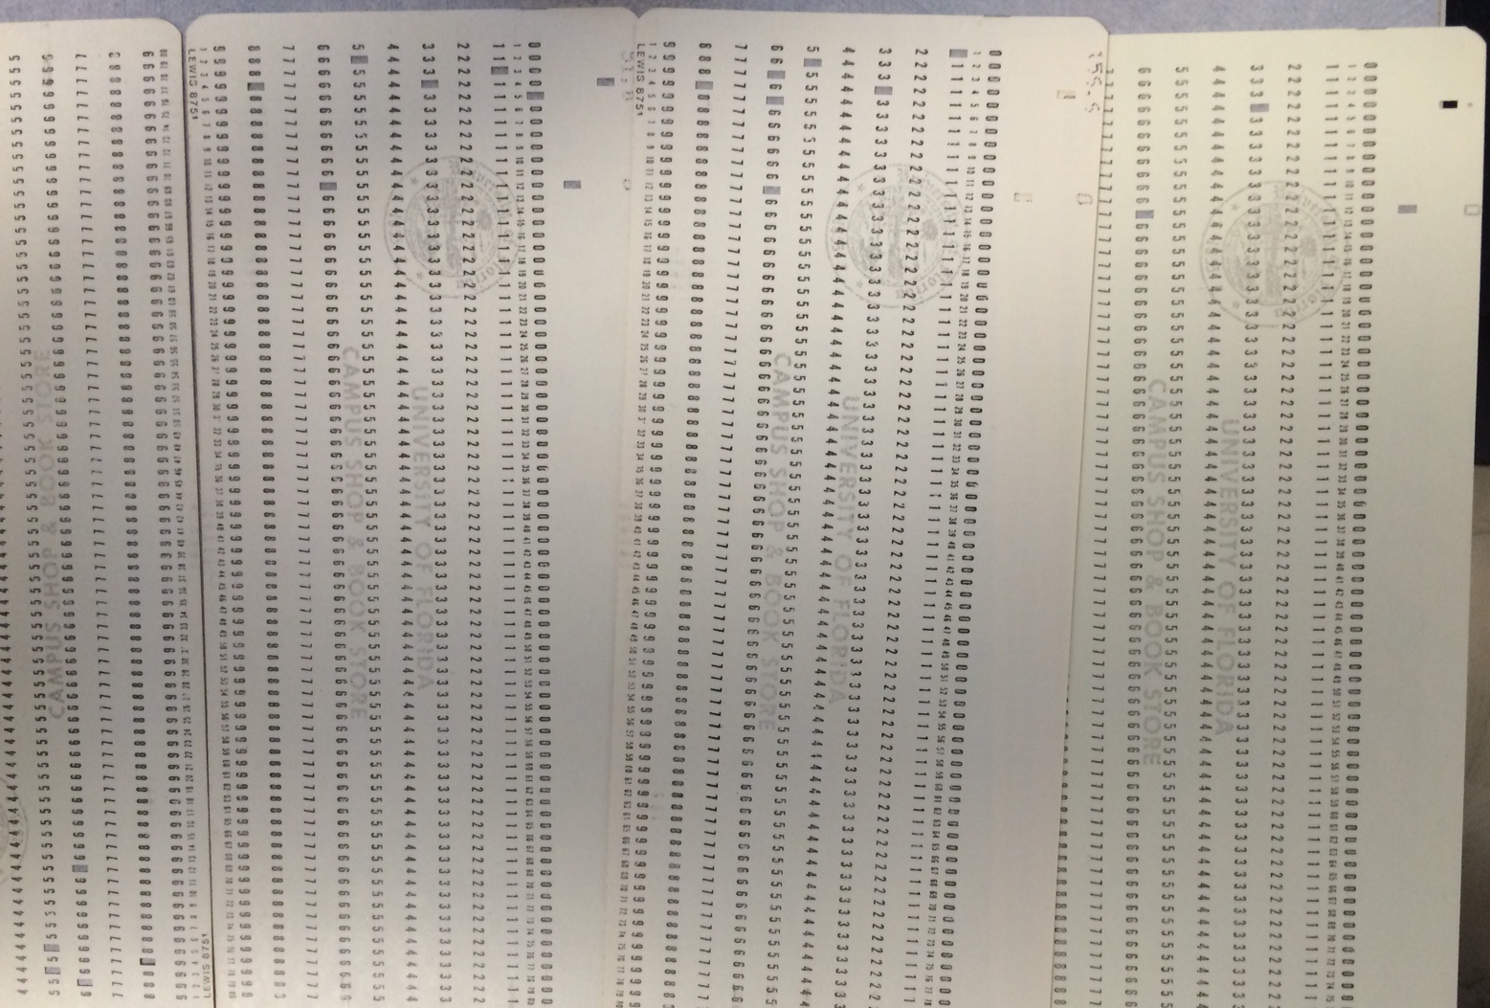
Putz, F.E., Biotropica, 1983
(courtesy of FE Putz)

Slide 25
With that in mind….
Identify different kinds of data collected in different disciplines
How are these data collected / recorded?
But first….

